Slide 1
Introduction to Automation Testing Using Selenium

Slide 2
What is Automation Testing?
Automation Testing or Test Automation is a software testing technique that performs using special automated testing software tools to execute a test case suite
The automation testing software can also enter test data into the System Under Test, compare expected and actual results and generate detailed test reports. Test Automation demands considerable investments of money and resources.
Once the test suite is automated, no human intervention is required. This improved ROI of Test Automation. The goal of Automation is to reduce the number of test cases to be run manually and not to eliminate Manual Testing altogether.
Manual Testing is performed by a human sitting in front of a computer carefully executing the test steps.

Slide 3
Why Test Automation?
Test Automation is the best way to increase the effectiveness, test coverage, and execution speed in software testing
Manual Testing of all workflows, all fields, all negative scenarios is time and money consuming
It is difficult to test for multilingual sites manually
Test Automation does not require Human intervention. You can run automated test unattended (overnight)
Test Automation increases the speed of test execution
Automation helps increase Test Coverage
Manual Testing can be error-prone.

Slide 4
Which Test Cases to Automate?
High Risk - Business Critical test cases
Test cases that are repeatedly executed
Test Cases that are very tedious or difficult to perform manually
Test Cases which are time-consuming

Slide 5
Category of test cases are not suitable for automation:
Test Cases that are newly designed and not executed manually at least once
Test Cases for which the requirements are frequently changing
Test cases which are executed on an ad-hoc basis.

Slide 6
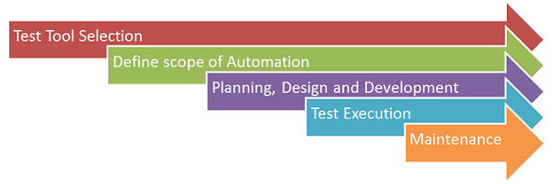
Automated Testing Process:
Step 1) Test Tool Selection
Step 2) Define scope of Automation
Step 3) Planning, Design and Development
Step 4) Test Execution
Step 5) Maintenance

Slide 7
Test tool selection
Test Tool selection largely depends on the technology the Application Under Test is built on. For instance, QTP does not support Informatica. So QTP cannot be used for testing Informatica applications. It's a good idea to conduct a Proof of Concept of Tool on AUT.

Slide 8
Define the scope of Automation
The features that are important for the business
Scenarios which have a large amount of data
Common functionalities across applications
Technical feasibility
The extent to which business components are reused
The complexity of test cases
Ability to use the same test cases for cross-browser testing

Slide 9
Planning, Design, and Development
Automation tools selected
Framework design and its features
In-Scope and Out-of-scope items of automation
Automation testbed preparation
Schedule and Timeline of scripting and execution
Deliverables of Automation Testing

Slide 10
Test Execution
Automation Scripts are executed during this phase. The scripts need input test data before there are set to run. Once executed they provide detailed test reports.
Execution can be performed using the automation tool directly or through the Test Management tool which will invoke the automation tool.
Example: Quality center is the Test Management tool which in turn it will invoke QTP for execution of automation scripts. Scripts can be executed in a single machine or a group of machines. The execution can be done during the night, to save time.

Slide 11
Test Automation Maintenance Approach
Test Automation Maintenance Approach is an automation testing phase carried out to test whether the new functionalities added to the software are working fine or not. Maintenance in automation testing is executed when new automation scripts are added and need to be reviewed and maintained in order to improve the effectiveness of automation scripts with each successive release cycle.

Slide 12
Difference Between Manual Testing and Automation Testing
Processing time | Automated testing is significantly faster than a manual approach. | Manual testing is time-consuming and takes up human resources.
Exploratory Testing | Automation does not allow random testing | Exploratory testing is possible in Manual Testing
Initial investment | The initial investment in the automated testing is higher. Though the ROI is better in the long run. | The initial investment in the Manual testing is comparatively lower. ROI is lower compared to Automation testing in the long run.
Reliability | Automated testing is a reliable method, as it is performed by tools and scripts. There is no testing Fatigue. | Manual testing is not as accurate because of the possibility of the human errors.

Slide 13
UI Change | For even a trivial change in the UI of the AUT, Automated Test Scripts need to be modified to work as expected | Small changes like change in id, class, etc. of a button wouldn't thwart execution of a manual tester.
Investment | Investment is required for testing tools as well as automation engineers | Investment is needed for human resources.
Cost-effective | Not cost effective for low volume regression | Not cost effective for high volume regression.
Test Report Visibility | With automation testing, all stakeholders can login into the automation system and check test execution results | Manual Tests are usually recorded in an Excel or Word, and test results are not readily/ readily available.
When to Use? | Automated Testing is suited for Regression Testing, Performance Testing, Load Testing or highly repeatable functional test cases. | Manual Testing is suitable for Exploratory, Usability and Adhoc Testing. It should also be used where the AUT changes frequently.
Performance Testing | Performance Tests like Load Testing, Stress Testing, Spike Testing, etc. have to be tested by an automation tool compulsorily. | Performance Testing is not feasible manually

Slide 14
What is Selenium?
Selenium is a free (open-source) automated testing framework used to validate web applications across different browsers and platforms.
You can use multiple programming languages like Java, C#, Python etc to create Selenium Test Scripts.
Testing done using the Selenium testing tool is usually referred to as Selenium Testing.

Slide 15
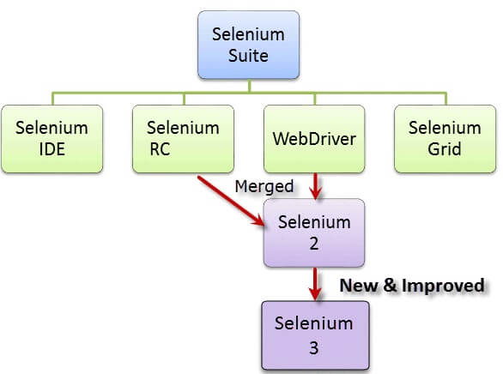
Structure of Selenium

Slide 16
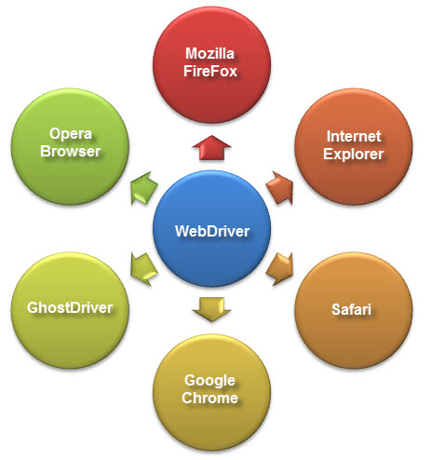
What is Selenium Webdriver?
The Selenium Webdriver tool is used for automating web application testing to verify that it works as expected or not. It mainly supports browsers like Firefox, Chrome, Safari and Internet Explorer. It also permits you to execute cross-browser testing.
Java
.Net
PHP
Python
Perl
Ruby

Slide 17
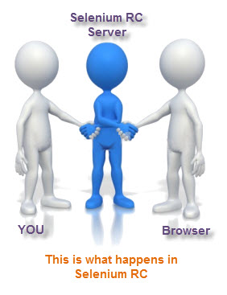
How it interacts with Browser

Slide 18
What is XPath in Selenium?
XPath in Selenium is an XML path used for navigation through the HTML structure of the page.

